Slide 1
Introduction to React
Friday, Jan. XX, XXXX

Slide 2
Some More Pts. On React
How does React Work?
creates a VIRTUAL DOM
changes what needs to be changed!
React.JS History
Current version of React.JS is V18.0.0 (April 2022).
Initial Release in July 2013.
It was first used in 2011 for Facebook's.
Created by Facebook Software Engineer, Jordan Walke.
Create-react-app includes built tools such as webpack, Babel, and ESLint.

Slide 3
Content
React Introduction
Compare with Angular
React Getting Started
Upgrade to React 18.
React ES6
React Render HTML
React JSX
React Components
React Function Components
React Props
React Events
React Condition
React Lists
React Forms
React Router
React Memo
React css Styling
React Sass Styling
React Hooks

Slide 4
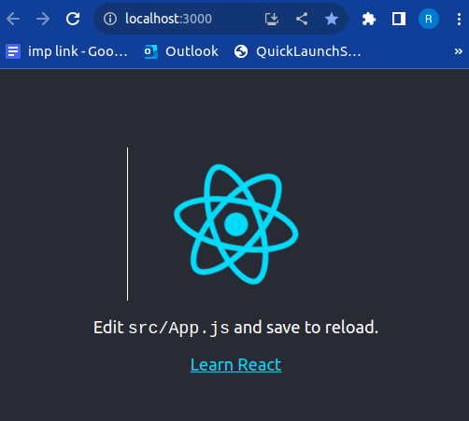
React Getting Started
Setting up an Environment and Creating React App.
Install Node.js (https://nodejs.org/en/download)
npx create-react-app training-app
cd training-app
npm start
cd my-react-app

Slide 5
Upgrade to React 18
Two steps to upgrade to React 18
Step 1: Install React 18
npm i react@latest react-dom@latest
Step 2: Use the new root API
// Earlier import ReactDOM from 'react-dom'; ReactDOM.render(<App />, document.getElementById('root')); // Updated version import ReactDOM from 'react-dom/client'; const root = ReactDOM.createRoot(document.getElementById('root')); root.render(<App />);

Slide 6
React Render HTML
React's goal is in many ways to render HTML in a web page.
Function createRoot()
Method render()
Example: Display a paragraph inside an element with the id of "root":
Root directory > public > index.html
<body> <div id="root"></div> // root node </body>
const container = document.getElementById('root'); const root = ReactDOM.createRoot(container); root.render(<p>Hello</p>);

Slide 7
React JSX
What is JSX?
JSX stands for JavaScript XML. It allows us to write HTML in React and makes it easier to write and add HTML in React. JSX allows us to write HTML elements in JavaScript and place them in the DOM without any createElement() and/or appendChild() methods. JSX converts HTML tags into react elements.
Examples:
With JSX:
const myElement = <h1>Hello!</h1>; const root = ReactDOM.createRoot(document.getElementById('root')); root.render(myElement);
Without JSX:
const myElement = React.createElement('h1', {}, 'Hello!');
const root = ReactDOM.createRoot(document.getElementById('root')); root.render(myElement);

Slide 8
Expressions in JSX
With JSX you can write expressions inside curly braces { }.
The expression can be a React variable, or property, or any other valid JavaScript expression. JSX will execute the expression and return the result:
Example 1:
Expression: {5 + 5}
const myElement = <h1>{5 + 5} is greater then 1.</h1>;
Output: 10 is greater then 1.
Example 2:
If Large block:
const myElement = (
<ul>
<li>Apples</li>
<li>Bananas</li>
<li>Cherries</li>
</ul>
);
Output:
Apples
Bananas
Cherries

Slide 9
Some Rules to be followed while writing code in react.
One Top Level Element
The HTML code must be wrapped in ONE top level element.
So if you like to write two paragraphs, you must put them inside a parent element, like a div element.
Rule 1:
Wrap two paragraphs inside one DIV element:
const myElement = ( <div> <p>I am a paragraph.</p> <p>I am a paragraph too.</p> </div> );
Rule 2:
Alternatively, you can use a "fragment" to wrap multiple lines. This will prevent unnecessarily adding extra nodes to the DOM.
A fragment looks like an empty HTML tag: <></>.
Rule 3:
Elements Must be Closed. JSX follows XML rules, and therefore HTML elements must be properly closed.
A fragment looks like an empty HTML tag: <></>.
Close empty elements with />
const myElement = <input type="text" />;

Slide 10
Rule 4:
Use attribute className instead of class in JSX:
Example:
const myElement = <h1 className="myclass">Hello World</h1>;
Conditions - if statements
React supports if statements, but not inside JSX.
To be able to use conditional statements in JSX, you should put the if statements outside of the JSX, or you could use a ternary expression instead:
Option 1:
Write if statements outside of the JSX code:
Example:
const x = 5; let text = "Goodbye"; if (x < 10) { text = "Hello"; } const myElement = <h1>{text}</h1>;
Option 2:
Use ternary expressions instead::
Example: Write "Hello" if x is less than 10, otherwise "Goodbye":
const x = 5; const myElement = <h1>{(x) < 10 ? "Hello" : "Goodbye"}</h1>;

Slide 11
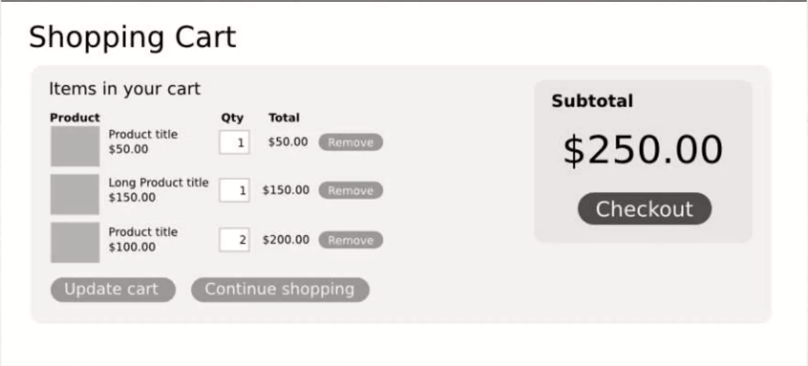
React Components
“In React, everything is a component”
Components are like functions that return HTML elements. Components are independent and reusable bits of code. They serve the same purpose as JavaScript functions, but work in isolation and return HTML
Cart Component
Components let you split the UI into independent,
reusable pieces, and Think about each pieces of
Isolation. Conceptually components are like javascript
functions. They accept Arbitarary inputs (called "props")
and return React elements describing What should
Appear on the screen.

Slide 12
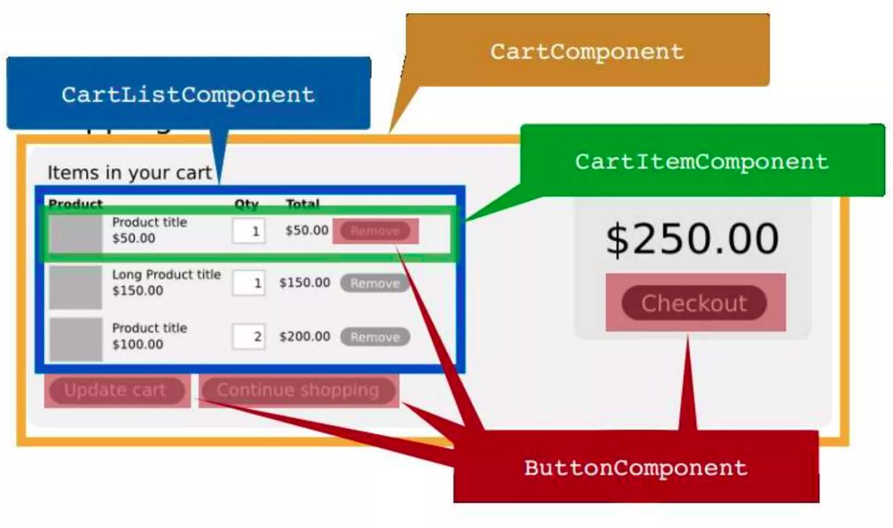

Slide 13
Components come in two types.
Class components.
Function components
Differences:
// Class Component
class A extends React.Component { render() { return <h2>Hi, How are you?</h2>; } }
// Function component
function A() { return <h2>Hi, How are you?</h2>; }
Components in Components
We can refer to components inside other components:
function A() { return <h2>Where are you?</h2>; } function B() { return ( <> <h1>I am in Delhi.</h1> <A/> </> ); }

Slide 14
Components in Files
React is all about re-using code, and it is recommended to split your components into separate files.
To do that, create a new file with a .js file extension and put the code inside it:
Rule: The filename must start with an uppercase character.
Example:
Below are the two files name:
User.js
import React from 'react';
function User() { return <h2>Hi, My name is Jon!</h2>; } export default User;
__________________________________
UserDetails.js import React from 'react';
import User from './User; function UserDetails() { return <User/>; } export default UserDetails;

Slide 15
React Props
Component props
Props is what can be pass into the component via attributes.
Props is the only way to inputs data. (or use Redux)
Props are immutable .
Child component will received data from parent via props.
React Props are like function arguments in JavaScript and attributes in HTML.
Example:
const myElement = <Abc brand="Ford" />; // use as attribute
function Abc(props) { // use as arguments return <h2>I am a { props.brand }!</h2>;
}

Slide 16
React Events
Just like HTML DOM events, React can perform actions based on user events.
React has the same events as HTML: click, change, mouseover etc.
Adding Events
React events are written in camelCase syntax:
onClick instead of onclick.
React event handlers are written inside curly braces:
onClick={shoot} instead of onClick="shoot()".
In React : <button onClick={shoot}>Take the Shot!</button>
In HTML: <button onclick="shoot()">Take the Shot!</button>
Passing Arguments
To pass an argument to an event handler, use an arrow function.
Example:
function Football() { const shoot = (a) => { alert(a); } return ( <button onClick={() => shoot("Goal!")}>Take the shot!</button> ); }

Slide 17
React Event Object
Event handlers have access to the React event that triggered the function.
In our example the event is the "click" event.
Example:
function Submit() { const data= (a, b) => { alert(b.type); } return ( <button onClick={(event) => data("Goal!", event)}>Fetch Data!!</button> ); }

Slide 18
React Conditional Rendering
In React, components can we render conditionally.
Following are the ways to use component rendering conditionally with example.
if Statement
Examples:
function MissedGoal() { return <h1>MISSED!</h1>; } function MadeGoal() { return <h1>Goal!</h1>; }

Slide 19
function Goal(props) { const isGoal = props.isGoal; if (isGoal) { return <MadeGoal/>; } return <MissedGoal/>; }
______________________
<Goal isGoal={false} />
2. Logical && Operator
Examples:
We can embed JavaScript expressions in JSX by using curly braces:
function Garage(props) { const cars = props.cars; return ( <> <h1>Garage</h1> {cars.length > 0 && <h2> You have {cars.length} cars in your garage. </h2> } </> ); }

Slide 20
const cars = ['Ford', 'BMW', 'Audi'];
<Garage cars={cars} />
3. Ternary Operator
Examples:
condition ? true : false
function Goal(props) { const isGoal = props.isGoal; return ( <> { isGoal ? <MadeGoal/> : <MissedGoal/> } </> ); }
<Goal isGoal={false} />

Slide 21
React lists
In React, you will render lists with some type of loop.
The JavaScript map() array method is generally the preferred method.
Example 1 : if Statement
function Container(props) { return <li>I am a { props.brand }</li>; }
function Alphabet() { const letters= ['A', 'B', 'C']; return ( <> <h1>Who lives in my garage?</h1> <ul> {letters.map((alpha) => <Container brand={alpha} />)} </ul> </> ); }

Slide 22
Keys
Keys allow React to keep track of elements. This way, if an item is updated or removed, only that item will be re-rendered instead of the entire list.
Keys need to be unique to each sibling. But they can be duplicated globally.
Example:
function Car(props) { return <li>I am a { props.brand }</li>; } function Garage() { const cars = [ {id: 1, brand: 'Ford'}, {id: 2, brand: 'BMW'}, {id: 3, brand: 'Audi'} ]; return ( <> <h1>Who lives in my garage?</h1> <ul> {cars.map((car) => <Car key={car.id} brand={car.brand} />)} </ul> </> ); }

Slide 23
React Router
React router is use to manage the route. Its mapping of url and component.
Create React App doesn't include page routing.
React Router is the most popular solution.
Add React Router
To add React Router in your application, run this in the terminal from the root directory of the application:
npm i –D react-router-dom
Folder Structure:
To create an application with multiple page routes, let's first start with the file structure.
Within the src folder, we'll create a folder named pages with several files:
src\pages\:
Layout.js
Home.js
Blogs.js
Contact.js
NoPage.js
Each file will contain a very basic React component.

Slide 24
Basic Usage
Now we will use our Router in our index.js file.
Example:
Use React Router to route to pages based on URL:
index.js:
import ReactDOM from "react-dom/client"; import { BrowserRouter, Routes, Route } from "react-router-dom"; import Layout from "./pages/Layout"; import Home from "./pages/Home"; import Blogs from "./pages/Blogs"; import Contact from "./pages/Contact"; import NoPage from "./pages/NoPage"; export default function App() { return ( <BrowserRouter> <Routes> <Route path="/" element={<Layout />}> <Route index element={<Home />} /> <Route path="blogs" element={<Blogs />} /> <Route path="contact" element={<Contact />} /> <Route path="*" element={<NoPage />} /> </Route> </Routes> </BrowserRouter> ); }

Slide 25
Explained with Example:
We wrap our content first with <BrowserRouter>.
Then we define our <Routes>. An application can have multiple <Routes>. Our basic example only uses one.
<Route>s can be nested. The first <Route> has a path of / and renders the Layout component.
The nested <Route>s inherit and add to the parent route. So the blogs path is combined with the parent and becomes /blogs.
The Home component route does not have a path but has an index attribute. That specifies this route as the default route for the parent route, which is /.
Setting the path to * will act as a catch-all for any undefined URLs. This is great for a 404 error page.
Pages / Components
The Layout component has <Outlet> and <Link> elements.
The <Outlet> renders the current route selected.
<Link> is used to set the URL and keep track of browsing history.
Anytime we link to an internal path, we will use <Link> instead of <a href="">.
The "layout route" is a shared component that inserts common content on all pages, such as a navigation menu.

Slide 26
React memo
Using memo will cause React to skip rendering a component if its props have not changed.
This can improve performance.

Slide 27
React css styling
1
Three ways to style React with CSS:
Inline styling
CSS stylesheets
CSS Modules
1. Inline Styling
To style an element with the inline style attribute, the value must be a JavaScript object:
Example:
two sets of curly braces {{}}
camelCased Property Names
Insert an object with the styling information:
const Header = () => { return ( <> <h1 style={{color: "red"}}>Hello Style!</h1> <p>Add a little style!</p> </> ); }

Slide 28
JavaScript Object:
You can also create an object with styling information, and refer to it in the style attribute:
const Users= () => { const headStyle = { color: "white", backgroundColor: "DodgerBlue", padding: "10px", fontFamily: "Sans-Serif" }; return ( <> <h1 style={headStyle }>Inline Style Example with object!</h1>
</> ); }

Slide 29
2. CSS Stylesheet:
You can write your CSS styling in a separate file, just save the file with the .css file extension, and import it in your application.:
Create file App.css and Import the stylesheet in your application:
body { background-color: #282c34; color: white; padding: 40px; font-family: Sans-Serif; text-align: center; }
import React from 'react'; import ReactDOM from 'react-dom/client'; import './App.css'; const User= () => { return ( <> <h1>This is css stylesheet!</h1> <p>Add a little style!.</p> </> ); }

Slide 30
3. CSS Modules:
CSS Modules let you use the same CSS class name in different files without worrying about naming clashes.:
Button.module.css // file name
.error { background-color: red; }
another-stylesheet.css // fine name
.error { color: red; }
Button.js // fine name
import React, { Component } from 'react'; import styles from './Button.module.css'; // Import css modules stylesheet as styles import './another-stylesheet.css'; // Import regular stylesheet function Button () { render ( // reference as a js object return <button className={styles.error}>Error Button</button>; ) }

Slide 31
React Hooks
Hooks are a new addition in React 16.8. They let you use state and other React features without writing a class.
Example:
You must import Hooks from react.
Here we are using the useState Hook to keep track of the application state.
State generally refers to application data or properties that need to be tracked.
Hook Rules:
There are 3 rules for hooks:
Hooks can only be called inside React function components.
Hooks can only be called at the top level of a component.
Hooks cannot be conditional

Slide 32
Categories of Hooks:
Basic Hooks
useState
useEffect
useContext
Additional Hooks
useReducer
useCallback
useMemo
useRef
useImperativeHandle
useLayoutEffect
useDebugValue
useDeferredValue
useTransition
useId
Library Hooks
useSyncExternalStore
useInsertionEffect

Slide 33
React useState Hook
The React useState Hook allows us to track state in a function component.
State generally refers to data or properties that need to be tracking in an application.
Import useState
To use the useState Hook, we first need to import it into our component.
Example:
At the top of your component, import the useState Hook.
import { useState } from "react";
Initialize useState
We initialize our state by calling useState in our function component.
useState accepts an initial state and returns two values:
The current state.
A function that updates the state.
Example:
Initialize state at the top of the function component.
import { useState } from "react"; function FavoriteColor() { const [color, setColor] = useState(""); }
Notice that again, we are destructuring the returned values from useState.
The first value, color, is our current state.
The second value, setColor, is the function that is used to update our state.

Slide 34
Read State
We can now include our state anywhere in our component.
Example:
import { useState } from "react";
function FavoriteColor() { const [color, setColor] = useState("red"); return <h1>My favorite color is {color}!</h1> }
Update State
To update our state, we use our state updater function.
import { useState } from "react"; import ReactDOM from "react-dom/client"; function FavoriteColor() { const [color, setColor] = useState("red"); return ( <> <h1>My favorite color is {color}!</h1> <button type="button" onClick={() => setColor("blue")} >Blue</button> </> ) }

Slide 35
What Can State Hold:
The useState Hook can be used to keep track of strings, numbers, booleans, arrays, objects, and any combination of these!
We could create multiple state Hooks to track individual values.
Example:
import { useState } from "react"; import ReactDOM from "react-dom/client"; function Car() { const [brand, setBrand] = useState("Ford"); const [model, setModel] = useState("Mustang"); const [year, setYear] = useState("1964"); const [color, setColor] = useState("red"); return ( <> <h1>My {brand}</h1> <p> It is a {color} {model} from {year}. </p> </> ) }

Slide 36
Create a single Hook that holds an object:.
Example:
import { useState } from "react"; import ReactDOM from "react-dom/client"; function Car() { const [car, setCar] = useState({ brand: "Ford", model: "Mustang", year: "1964", color: "red" }); return ( <> <h1>My {car.brand}</h1> <p> It is a {car.color} {car.model} from {car.year}. </p> </> ) }

Slide 37
Updating Objects and Arrays in State:
When state is updated, the entire state gets overwritten.
What if we only want to update the color of our car?
If we only called setCar({color: "blue"}), this would remove the brand, model, and year from our state.
We can use the JavaScript spread operator to help us.
Because we need the current value of state, we pass a function into our setCar function. This function receives the previous value.
We then return an object, spreading the previousState and overwriting only the color.
As shown in example

Slide 38
Example:
Use the JavaScript spread operator to update only the color of the car:
import { useState } from "react"; import ReactDOM from "react-dom/client"; function Car() { const [car, setCar] = useState({ brand: "Ford", model: "Mustang", year: "1964", color: "red" }); const updateColor = () => { setCar(previousState => { return { ...previousState, color: "blue" } }); } return ( <><button type="button" onClick={updateColor} >Blue</button> </> ) }

